Slide 1
William Stallings
Computer Organization and Architecture
10th Edition
Chapter 5
Internal Memory & Chip Logic

Slide 2
Semiconductor Memory Types
Memory Type | Category | Volatility
Random-Access Memory (RAM) | Read-write memory | Volatile – must be provided with a constant power supply
Read-only Memory (ROM) | Read-only memory | Nonvolatile
Programmable ROM (PROM)
Erasable PROM (EPROM) | Read-mostly memory
Electrically Erasable PROM (EEPROM)
Flash Memory
PROM – small, written only once, special equipment is required for programming In read-mostly-memory, the Read op are far more frequent than write op EPROM – all storage cells must be erased to same initial state by an ultraviolet light, it takes 20 min to perform, can be used multiple times EEPROM – that can be written into at any time without erasing prior contents; only byte or bytes addressed are updated. Write op takes longer time than read op, 100 microsec/byte

Slide 3
Semiconductor Memory
RAM
  Misnamed as all semiconductor memory is random access (as all of the types listed in the previous table)
  Read/Write
  Volatile
  Temporary storage
  RAM technology is dived into two technologies:
  Dynamic and Static

Slide 4
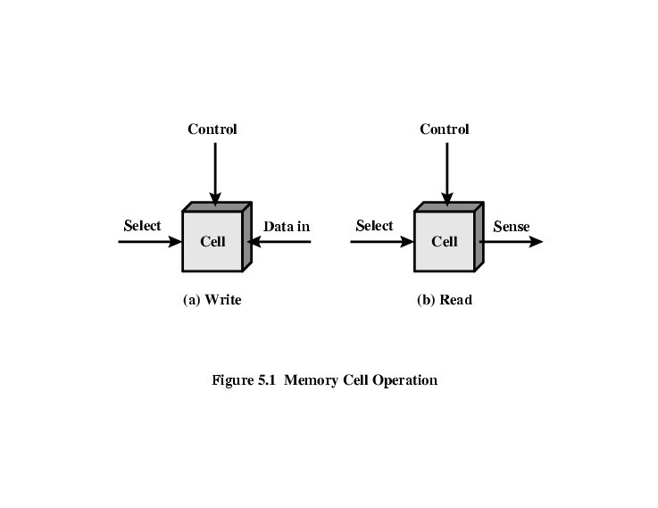
Memory Cell Operation
Select terminal – selects a memory cell for read/write operation
Control terminal – indicated read or write
For writing – data terminal provides an electrical signal that sets state of cell to 1 or 0
For reading – that terminal is used for output of cell’s state

Slide 5
Dynamic RAM
DRAM is made with cells that stores data as charge on capacitors, presence or absence of charge on a capacitor is interpreted as a binary 1 or 0
DRAM require periodic charge refreshing to maintain data storage i.e. Charges leak
Need refreshing even with power continuously applied
Simpler construction
Smaller per bit
Less expensive
Need refresh circuits
Slower
Main memory
Essentially analogue
  Level of charge determines value

Slide 6
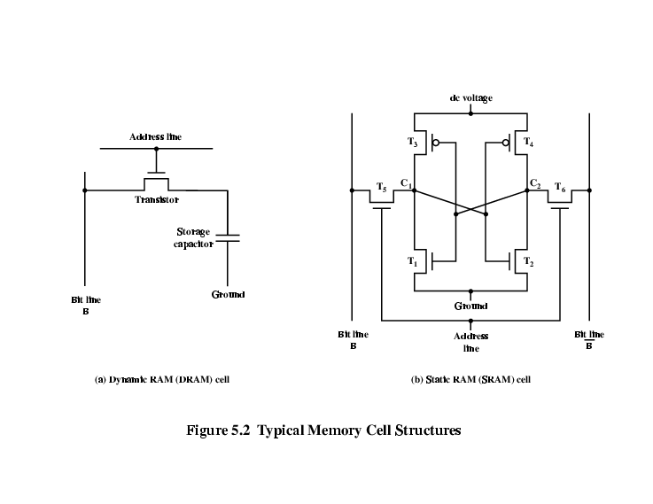
Dynamic RAM Structure
Here is an individual DRAM cell that stores one bit
Address line is activated when bit value from this cell is to be read or written
Transistor acts as a switch (allows current to flow) if a voltage is applied to address line and (no current flows) if no voltage is present on address line
For write op, a voltage signal is applied to bit line, (high for 1 and low for 0), a signal on address line allowing a charge to be transferred to capacitor
For read op, when address line is selected transistor turns on and charge stored on capacitor is fed out onto a bit line and to a sense amplifier, which compares capacitor voltage to a reference value, for 1 or 0

Slide 7
DRAM Operation
Address line active when bit read or written
  Transistor switch closed (current flows)
Write
  Voltage to bit line
    High for 1 low for 0
  Then signal address line
    Transfers charge to capacitor
Read
  Address line selected
    transistor turns on
  Charge from capacitor fed via bit line to sense amplifier
    Compares with reference value to determine 0 or 1
  Capacitor charge must be restored

Slide 8
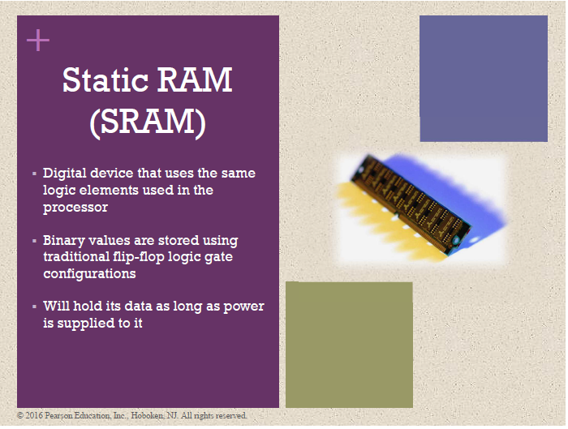
Static RAM

Slide 9
Static RAM
Bits stored as on/off switches
No charges to leak
It holds its data as long as power is supplied to it
More complex construction
Larger per bit
More expensive
Does not need refresh circuits
Faster
Cache
Digital
  Uses flip-flops logic-gate

Slide 10
Static RAM Structure
Transistor arrangement gives stable logic state 1,0
State 1 (logical 1 store)
  point C1 is high & point C2 is low
  T1 T4 off, T2 T3 on
State 0 (logical 0 store)
  C2 high, C1 low
  T2 T3 off, T1 T4 on
Address line controls two transistors T5, T6, when signal is applied to this line, T5 T6 are switch on, allowing read/write op
Write – apply value to B & its compliment to B*
Read – bit value is read from line B

Slide 11
SRAM v DRAM
Both volatile
  Power needed to preserve data
Dynamic cell
  Simpler to build, smaller
  More dense (i.e., smaller cell = more cells per unit area)
  Less expensive
  Needs refresh
  Larger memory units (used for main memory)
Static cell
  Faster than DRAMs
  Used for Cache memory (both on & off chip)

Slide 12
Read Only Memory (ROM)
Permanent storage
  Nonvolatile
Microprogramming (see later)
Library subroutines
Systems programs (BIOS)
Function tables

Slide 13
Types of ROM
Written during manufacture
  Very expensive for small runs
Programmable (once)
  PROM
  Needs special equipment to program
Read “mostly”
  Erasable Programmable (EPROM)
    Erased by UV
  Electrically Erasable (EEPROM)
    Takes much longer to write than read
  Flash memory
    Erase whole memory electrically

Slide 14
Organisation in detail (Chip Logic)
A 16Mbit chip can be organised as a 2048 x 2048 x 4bit array , (i.e., 4 M x 4)
  Reduces number of address pins
    Multiplex row address and column address
    11 pins to address (2¹¹=2048)
    Adding one more pin devoted to addressing doubles the number of rows and columns, so size of chip memory grows by a factor of 4

Slide 15
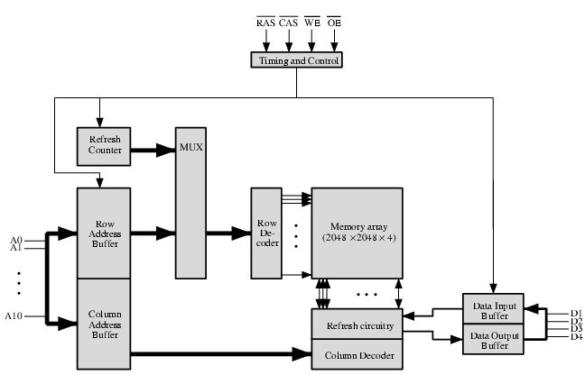
Fig: Typical 16-Mbit DRAM (4M x 4)
(4) Additional 11 address lines select one of 2048 columns of 4-bits, Four data lines are used for input/output of 4-bits to and from data buffer.
i.e. 22 required address lines are passed through select logic external to chip & multiplexed onto 11 address lines
WE and OE pins determine whether a write/read op is performed
(1) 4-bits are read/written at a time, A 16Mbit chip can be organised as a 2048 x 2048 x 4bit array, (2) Elements of array are connected by both horizontal-row (select terminal) and vertical-column (data-in/sense terminal) lines, (3) Address lines supply address of word to be selected, here 11 address lines are needed to select one of 2048 rows. These 11 lines are fed into a row decoder, which has 11 lines of input & 2048 lines for output, decoder activates a single one of 2048 outputs depending on bit pattern on 11 input lines (2¹¹ = 2048)

Slide 16
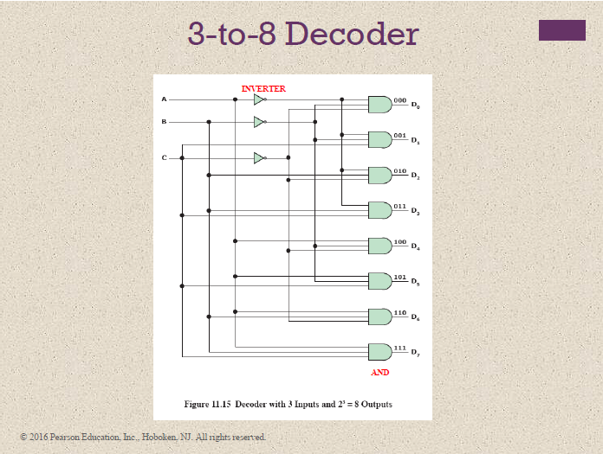

Slide 17
Chip Refreshing (DRAM)
All DRAMs require a refresh operation
Disable DRAM chip while all data cells are refreshed
Refresh Counter steps through all of rows values
For each row, output lines from refresh counter are supplied to row decoder & RAS line is activated
The data are Read-out & Written-back into same location
This causes each cell in the row to be refreshed
Takes time
Slows down apparent performance

Slide 18
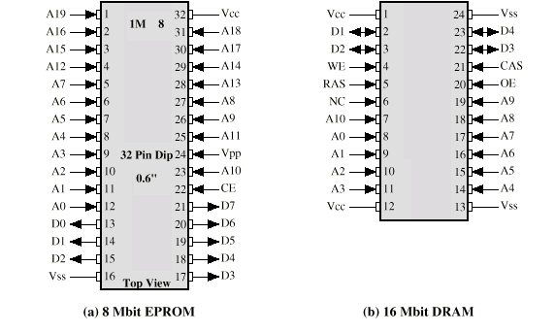
Chip Packaging
For a 16-Mbit chip organized as (4M x 4), different from ROM chip, because a RAM can be updated, the data pins are input/output.
WE & OE pins indicate whether this is a write or read op. Because DRAM is accessed by row and column, and address is multiplexed only 11 address pins are needed to specify 4M row/column combinations (2¹¹ x 2¹¹ = 4M)
No Connect (NC) pin is provided, so that there are an even no. of pins

Slide 19
Example: Chip Logic
An 8-Mbit chip can be organised as a (1Mx 8bit) array , (i.e., 1 M x 8)
  Dedicated - number of address pins
    Generate row address only
    20 pins to address (2²⁰= 1M)
    A

Slide 20
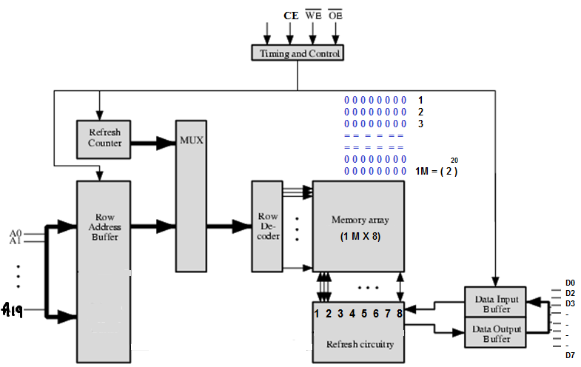
Fig: Typical 8-Mbit DRAM (1M x 8)
WE and OE pins determine whether a write/read op is performed, CE, Chip Enable
(1) 4-bits are read/written at a time, A 16Mbit chip can be organised as a 2048 x 2048 x 4bit array, (2) Elements of array are connected by both horizontal-row (select terminal) and vertical-column (data-in/sense terminal) lines, (3) Address lines supply address of word to be selected, here 11 address lines are needed to select one of 2048 rows. These 11 lines are fed into a row decoder, which has 11 lines of input & 2048 lines for output, decoder activates a single one of 2048 outputs depending on bit pattern on 11 input lines (2¹¹ = 2048)

Slide 21
Chip Packaging
For an 8-Mbit EPROM chip organized as (1M x 8), the package includes 32-pins, which support following signal lines:
address of the word being accessed. For 1M words, a total of 20 (2²⁰ = 1M) pins are needed (A0 – A19).
data to be read out, consisting of 8 lines (D0 – D7).
Power supply to chip (Vcc).
A ground pin (Vss).
A chip enable (CE) pin, to connect to more than one memory chip over same address bus.
A program voltage (Vpp) that is supplied during programming (write operations).

Slide 22
Error Correction
Hard Failure
  Permanent defect
Soft Error
  is a Random, non-destructive event alters contents of one or more memory cells without damaging memory, caused by power supply, or alpha particles in materials
Detected using Hamming error correcting code
- When data are to be read into memory, a calculation is performed on data to produce a code. Both code and data are stored, thus, if an M-bit word of data is to be stored, and the code is of length K bits, then actual size of stored word is (M + K) bits
- When previously stored word is read out, code is used to detect error & then correct the errors

Slide 23
Error detection & correction using Hamming code
Hamming Code on 4-bit words (M = 4), with three intersecting circle, & seven compartments, 4 data bits are placed at inner comp Fig(a), & other are filled with parity bits
Each parity bit is chosen so that total no. of 1s in its circle is even Fig(b), As circle A includes three data 1s, parity bit in that circle is set to 1
If an error changes one of data bits Fig(c), it is easily found, By checking parity bits, discrepancies are found in circle A & C but not in B, i.e. only one comp is in A&C but not B, correcting error by changing that bit
A
B
A
B
1
1
1
0
(a)
1
(b)
1
1
0
1
0
0
C
C
A
B
A
B
1
1
0
1
1
0
(c)
1
(d)
1
0
0
0
0
0
0
C
C

Slide 24
e.g., Hamming Code for 8-bit words
For Hamming Code how long the code must be. An error could occur on any of M data bits or K check bits, we must have (2^{k} – 1) > = (M + K)
E.g., for a word of 8 data bits (M = 8), we have
K = 3: 2³ -1 < 8+3
K = 4: 2⁴ -1 > 8+4 , (thus 8-data bits require 4-check bits, total of 12-bits word)
C1 = D1 * D2 * D4 * D5 * D7
C2 = D1 * D3 * D4 * D6 * D7
C4 = D2 * D3 * D4 * D8
C8 = D5 * D6 * D7 * D8
Check bits are calculated as
Bit position | 12 | 11 | 10 | 9 | 8 | 7 | 6 | 5 | 4 | 3 | 2 | 1
Position no | 1100 | 1011 | 1010 | 1001 | 1000 | 0111 | 0110 | 0101 | 0100 | 0011 | 0010 | 0001
Data bit | D8 | D7 | D6 | D5 |  | D4 | D3 | D2 |  | D1
Check bit |  |  |  |  | C8 |  |  |  | C4 |  | C2 | C1
e.g. C1 = D1 (0011) * D2 (0101) etc select all where first binary digit is 1 out of 4-bits

Slide 25
e.g., Hamming Code for 8-bit words
C1 = D1 , D2 , D4 , D5 , D7 (3, 5, 7, 9, 11 bit positions check with parity bit C1)
C2 = D1 , D3 , D4 , D6 , D7 (3, 6, 7, 10, 11 check with parity bit C2)
C4 = D2 , D3 , D4 , D8 (5, 6, 7, 8 with C4) D8 D7 D6 D5 D4 D3 D2 D1
C8 = D5 , D6 , D7 , D8 ; we have an 8-bit word is 0 0 1 1 1 0 0 1
C1 = 1 * 0 * 1 * 1 * 0 = 1
C2 = 1 * 0 * 1 * 1 * 0 = 1
C4 = 0 * 0 * 1 * 0 = 1
C8 = 1 * 1 * 0 * 0 = 0
Suppose data bit 3 sustain an error, changed from 0 to 1, when check bits are recalculated,
When new check bits are compared with old check bits,
Resultant word is formed:
i.e. result is 0 1 1 0 indicating that bit position 6,
which contains data bit 3, is in error
Originally Sent
Received As
C1 = 1 * 0 * 1 * 1 * 0 = 1
C2 = 1 * 1 * 1 * 1 * 0 = 0
C4 = 0 * 1 * 1 * 0 = 0
C8 = 1 * 1 * 0 * 0 = 0
C8 C4 C2 C1
0 1 1 1
0 0 0 1 *
-------------------------------
0 1 1 0

Slide 26
e.g., Hamming Code for 8-bit words
Bit position | 12 | 11 | 10 | 9 | 8 | 7 | 6 | 5 | 4 | 3 | 2 | 1
Position number | 1100 | 1011 | 1010 | 1001 | 1000 | 0111 | 0110 | 0101 | 0100 | 0011 | 0010 | 0001
Data bit | D8 | D7 | D6 | D5 |  | D4 | D3 | D2 |  | D1
Check bit |  |  |  |  | C8 |  |  |  | C4 |  | C2 | C1
Word stored as | 0 | 0 | 1 | 1 | 0 | 1 | 0 | 0 | 1 | 1 | 1 | 1
Word fetched as | 0 | 0 | 1 | 1 | 0 | 1 | 1 | 0 | 1 | 1 | 1 | 1
Position number | 1100 | 1011 | 1010 | 1001 | 1000 | 0111 | 0110 | 0101 | 0100 | 0011 | 0010 | 0001
Check bit |  |  |  |  | 0 |  |  |  | 0 |  | 0 | 1
Table : Single-error-correcting (SEC) & Check Bit Calculation

Slide 27
Hamming (DED) Code
0
0
0
1
1
0
1
(a)
1
(b)
1
(c)
0
1
0
1
0
1
0
0
0
C
1
0
1
1
0
1
1
0
1
(d)
0
(e)
0
(f)
0
1
0
1
1
1
1
0
0
0

Slide 28
Increase in Word length with Error Correction
 | Single-Error Correction |  | Single-Error Correction/ Double-Error Detection
Data Bits | Check Bits | % Increase (Overhead) | Check Bits | % Increase (Overhead)
8 | 4 | 50 | 5 | 62.5
16 | 5 | 31.25 | 6 | 37.5
32 | 6 | 18.75 | 7 | 21.875
64 | 7 | 10.94 | 8 | 12.5
128 | 8 | 6.25 | 9 | 7.03
256 | 9 | 3.52 | 10 | 3.91

Slide 29
Increase in Word length with Error Correction
How is the syndrome for the Hamming Code interpreted? Suppose a 12-bit data word stored in memory is 101000101101. Using the Hamming algorithm, determine what check bits would be stored in memory with the data word. Show how you got your answer.
Assume a stack-oriented processor that includes the stack operations PUSH and POP. Arithmetic operations automatically involve the top one or two stack elements. Begin with an empty stack. What stack elements remain after the following instructions are executed?
PUSH 4
PUSH 7
PUSH 8
ADD
PUSH 10
SUB
MUL
PUSH 9
ADD

Slide 30
Question…
Assume a stack-oriented processor that includes the stack operations PUSH and POP. Arithmetic operations automatically involve the top one or two stack elements. Begin with an empty stack. What stack elements remain after the following instructions are executed?
PUSH 4
PUSH 7
PUSH 8
ADD
PUSH 10
SUB
MUL
PUSH 9
ADD
Notes:
30

Slide 31
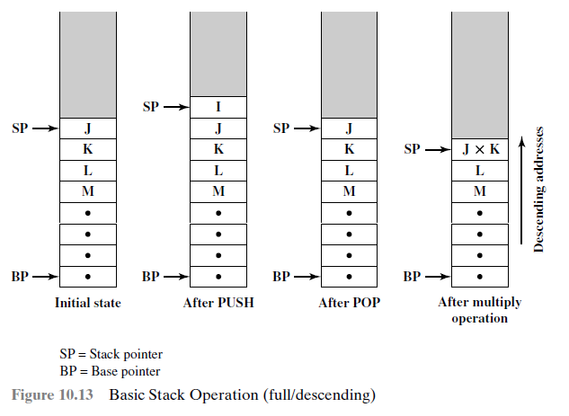

Slide 32
Synchronous DRAM (SDRAM)
Access is synchronized with an external clock
Address is presented to RAM
RAM finds data (CPU waits in conventional DRAM)
Since SDRAM moves data in time with system clock, CPU knows when data will be ready
CPU does not have to wait, it can do something else
Burst mode allows SDRAM to set up stream of data and fire it out in block

Slide 33
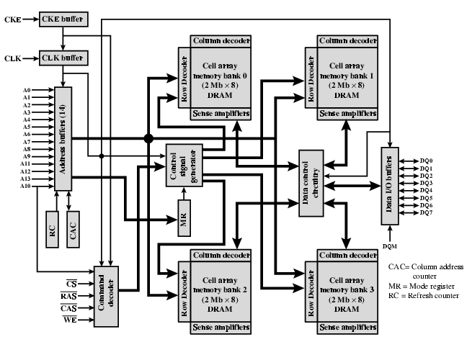
IBM 64Mb SDRAM

